Slide 1

PowerShell and Security
The how, what and why
Jaap Brasser
@Jaap_Brasser

Slide 2
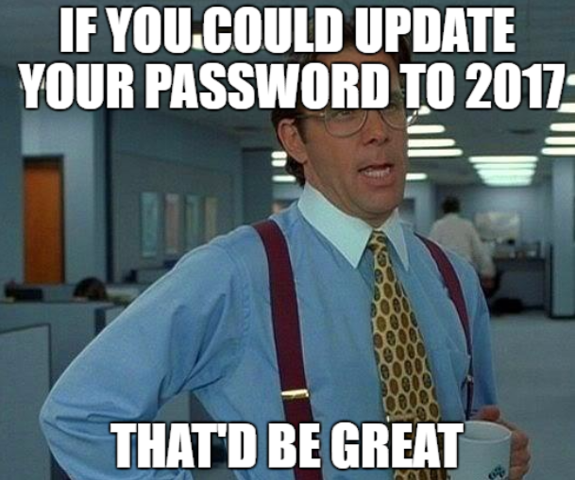
Most important information...
SSID: xxxxxxxx
Password: xxxxxxxx

Slide 3

About_Jaap
Dutch PowerShell User Group
Blogging
PowerShell Magazine
JaapBrasser.com
Slack
Reddit
GitHub
PowerShell Gallery
TechNet Forums/Gallery
@Jaap_Brasser

Slide 4
Agenda
PowerShell security
Malware and PowerShell
Configuring and securing PowerShell
Just enough administration (JEA)
Questions and discussion

Slide 5



Why does malware love PowerShell
Easy to automate
Available by default on modern OS
Access to .Net
Now also on Linux & Mac
Can run C#

Slide 6
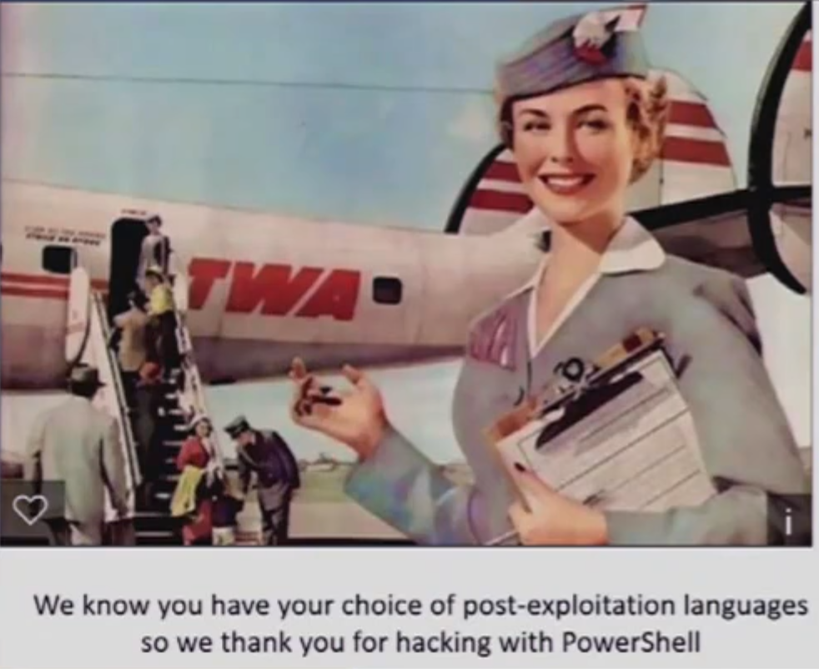
...

Slide 7
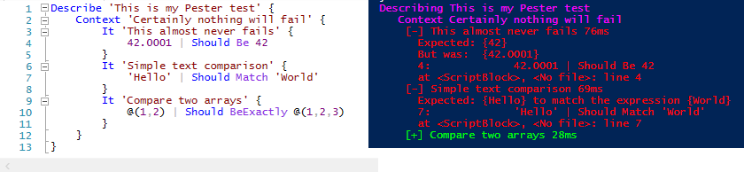
Demo 1 – Configure PS Logging

Slide 8
Demo Summary
How to configure PowerShell logging
The different logging mechanisms

Slide 9
Demo 2 – Obfuscate Logging

Slide 10
Demo Summary
How to obfuscate logging
What techniques are there
How to detect obfuscated code

Slide 11
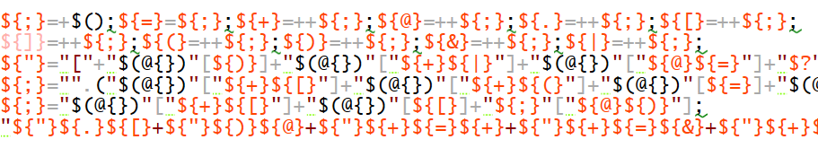
...

Slide 12
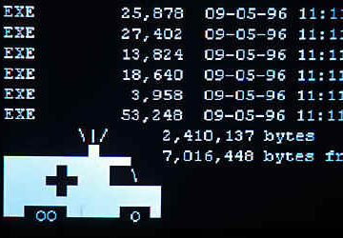
Compromized system

Slide 13
Just Enough Administration
Introduced in 2014
Delegated administration
Limit what users can do
Anything managed by PowerShell

Slide 14
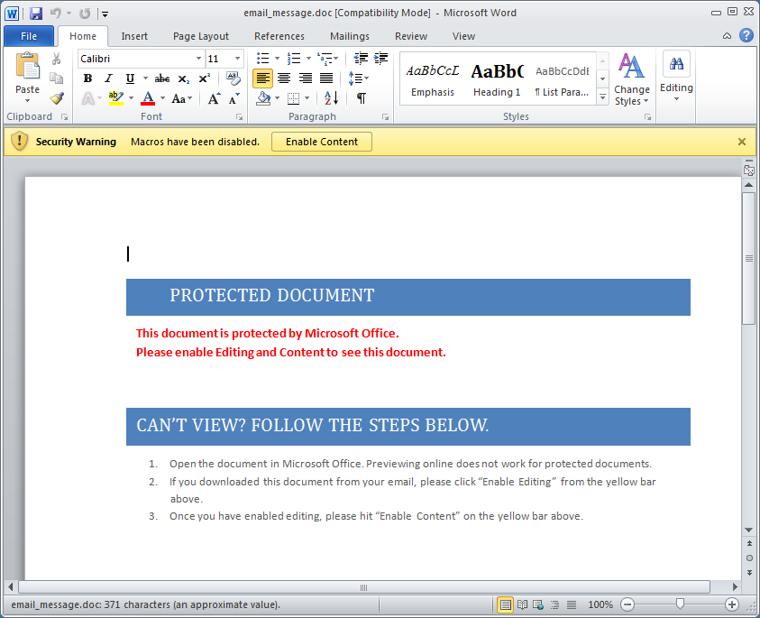
...

Slide 15
PowerShell Endpoints
Available in PowerShell since 2.0
Allows for delegation
Default endpoints
microsoft.powershell
microsoft.powershell.workflow
microsoft.powershell32

Slide 16
PowerShell Language Modes
Different language modes
FullLanguage
ConstrainedLanguage
RestrictedLanguage
NoLanguage
Determines what the console can do

Slide 17
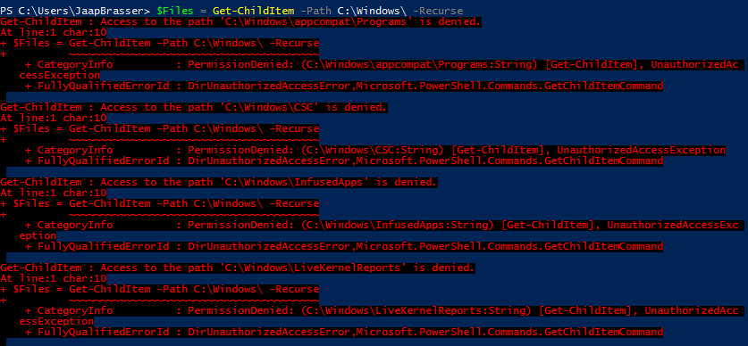
JEADemo1 – Create endpoints

Slide 18
Demo Summary
Created two endpoints
Viewed the resources used
View the generated start up script
View SDDL

Slide 19
JEADemo2 – Connect JEA endpoint

Slide 20
Demo Summary
Connect to a JEA endpoint
View the output
What is retricted in the languagemode

Slide 21
JEADemo3 – Edit Configuration

Slide 22
Demo Summary
Use a non-administrative user
Configure single user SDDL
Change the start up script
Can be used to set own defaults

Slide 23
JEADemo4 – GUI Uses for JEA

Slide 24
Demo Summary
Use JEA endpoint for GUI apps
Use JEA endpoint in scripts

Slide 25
Questions?
powershell.reageer.tv

Slide 26
Learn more about PowerShell
github.com/PowerShell/PowerShell
www.powershellmagazine.com
www.dupsug.com
www.jaapbrasser.com/how-learn-powershell
Github.com/jaapbrasser/events

